Slide 1

Grade 11 Unit 5
Think and Write Worksheet
START
by Demet Hoca

Slide 2

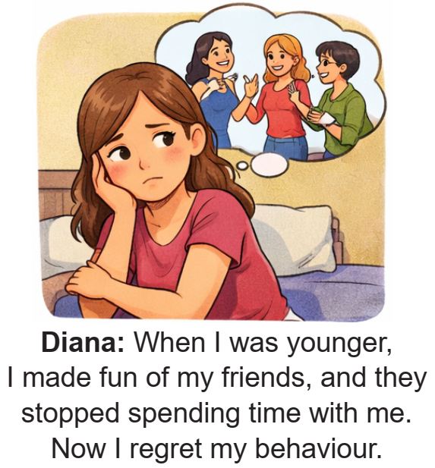
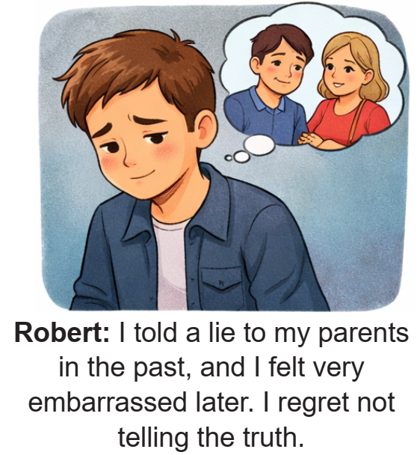
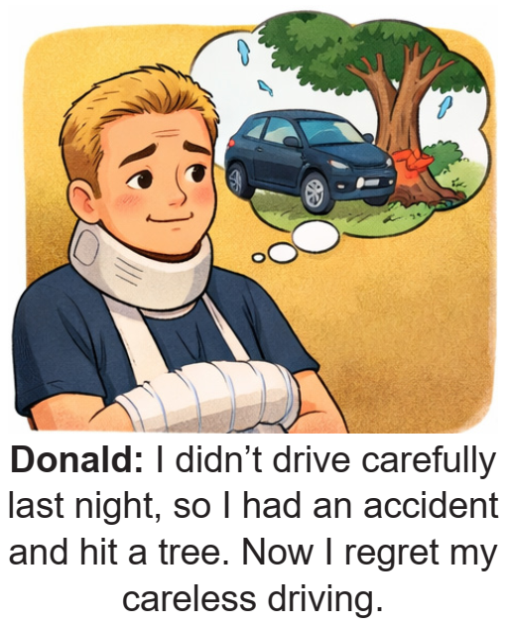
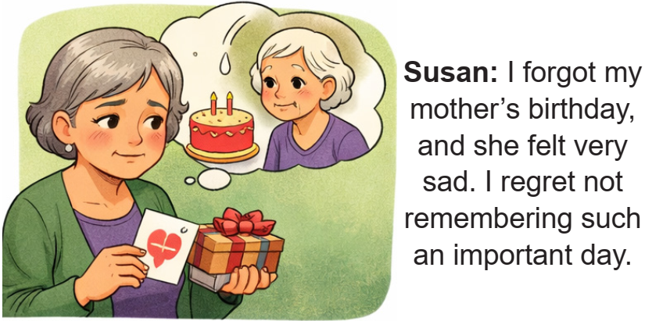
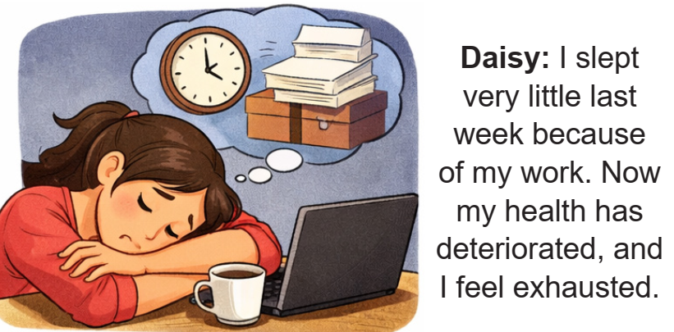


Susan
Diana
Daisy
Robert
Donald

Slide 3

e
d
b
a
c

Slide 4
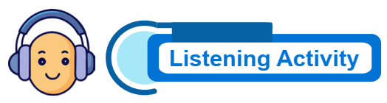


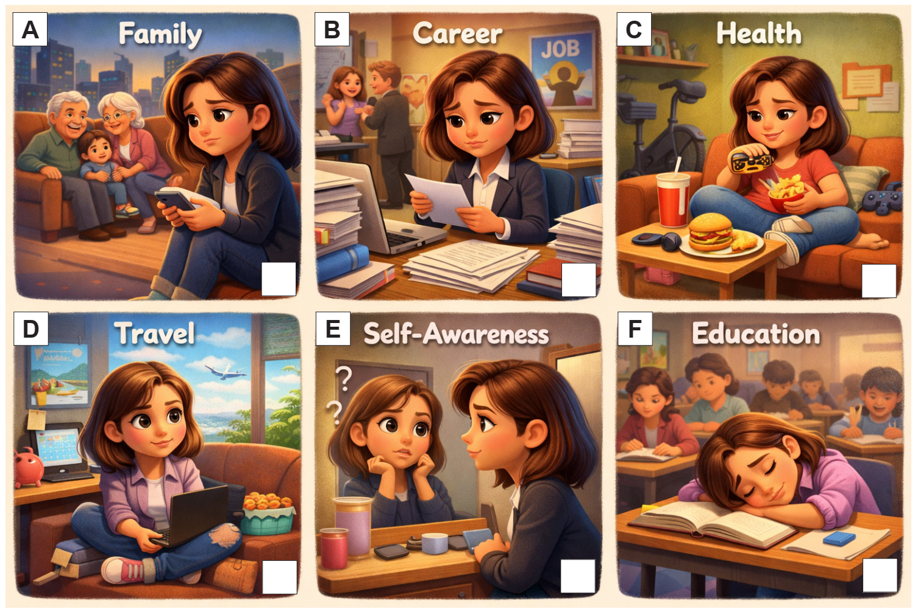
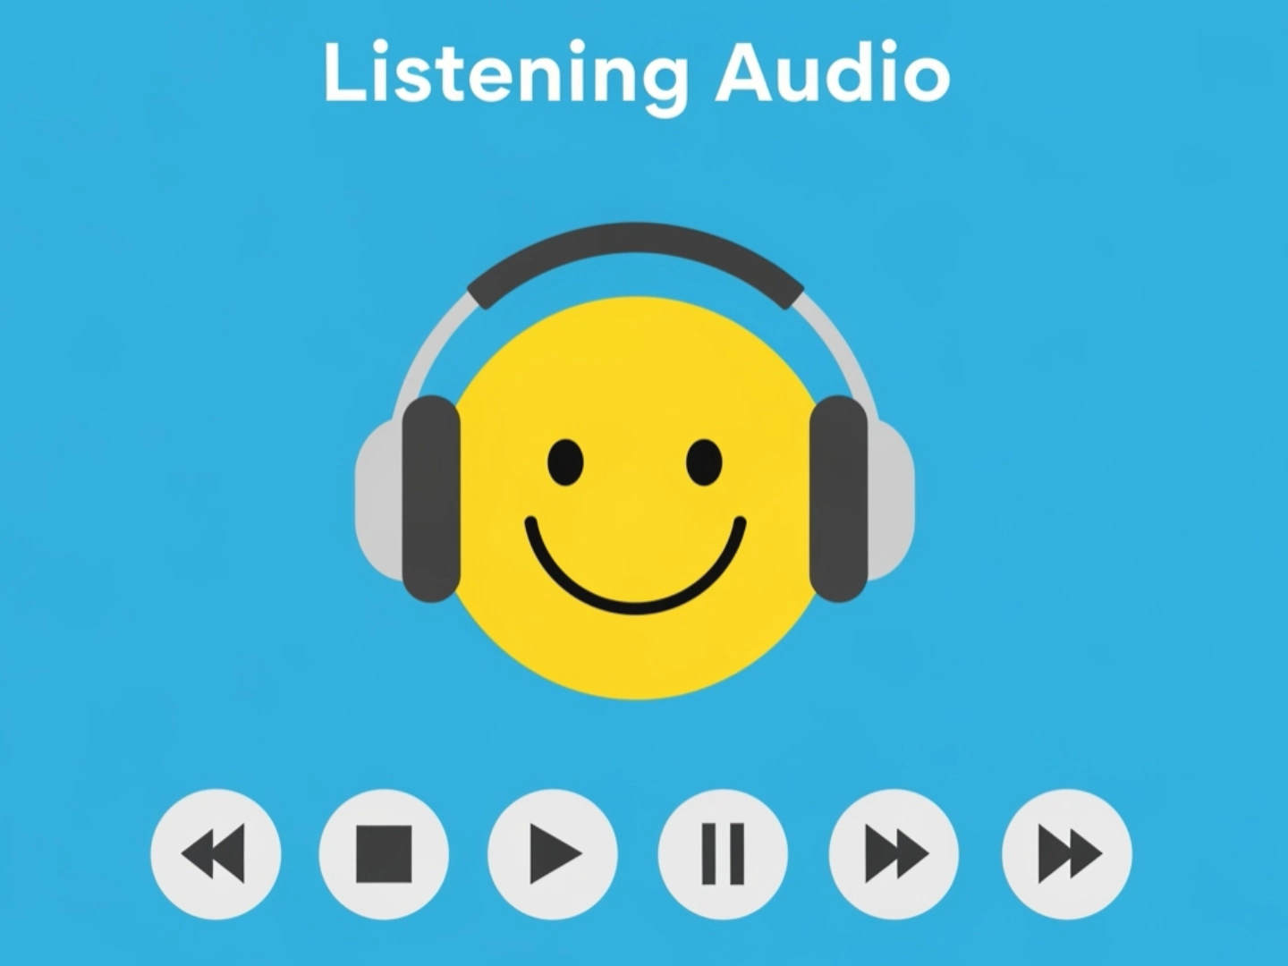
See Text
5
3
6
1
4
2

Slide 5

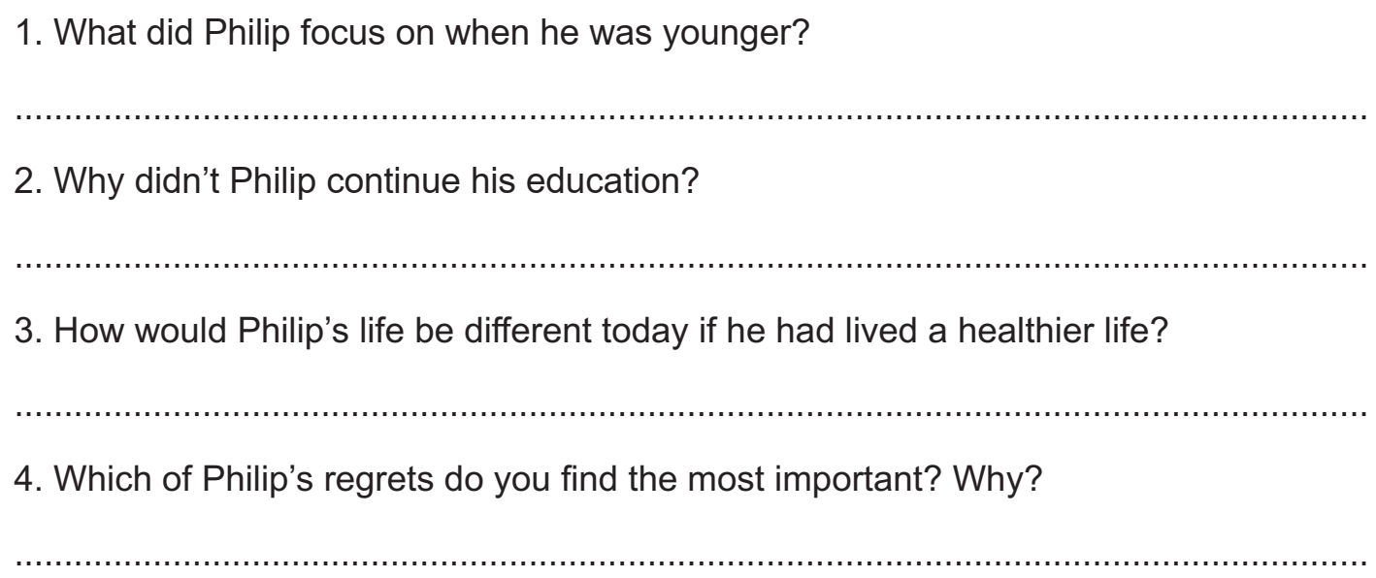
He focused too much on his career.
Because he wanted to start earning money early.
He would have more energy today.
I find his regret about not taking his health seriously the most
important because health affects every part of life.

Slide 6


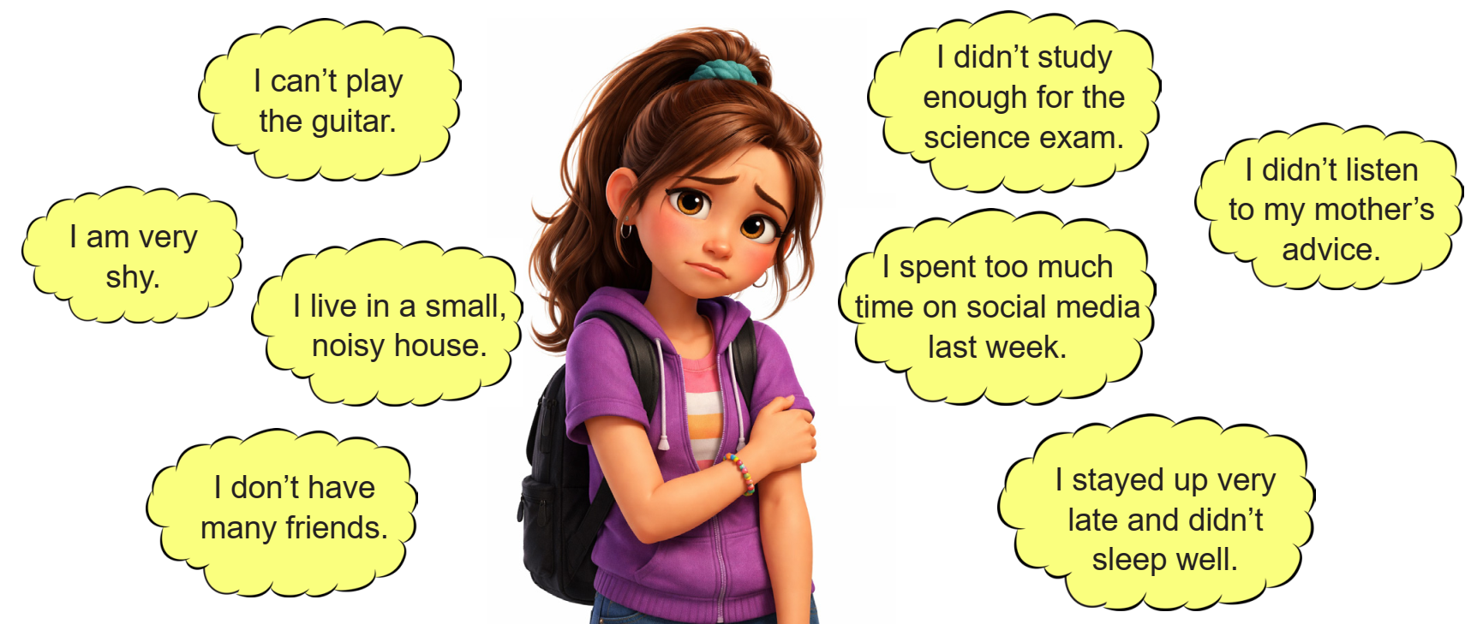


she could play the guitar.
she had studied harder for the science exam.

Slide 7


she were not shy.
she had not spent so much time on social media.

Slide 8


she lived in a big, quiet house.
she had listened to her mother.

Slide 9


she had more friends.
she had gone to bed earlier.

Slide 10

I wish I were more confident when I speak in public.
I wish I had studied harder for my exams last year.
I wish I had more free time to focus on my hobbies.
I wish I hadn’t spent so much time on social media.

Slide 11

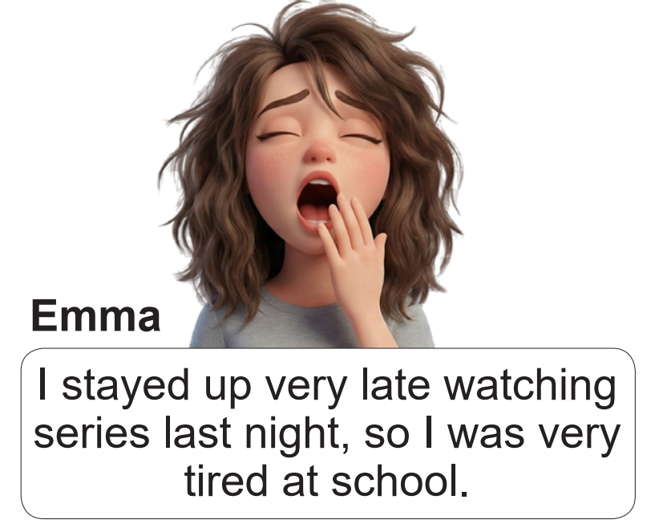
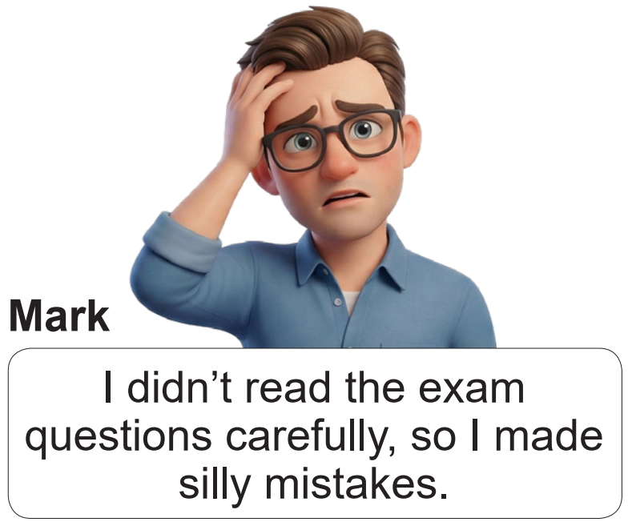
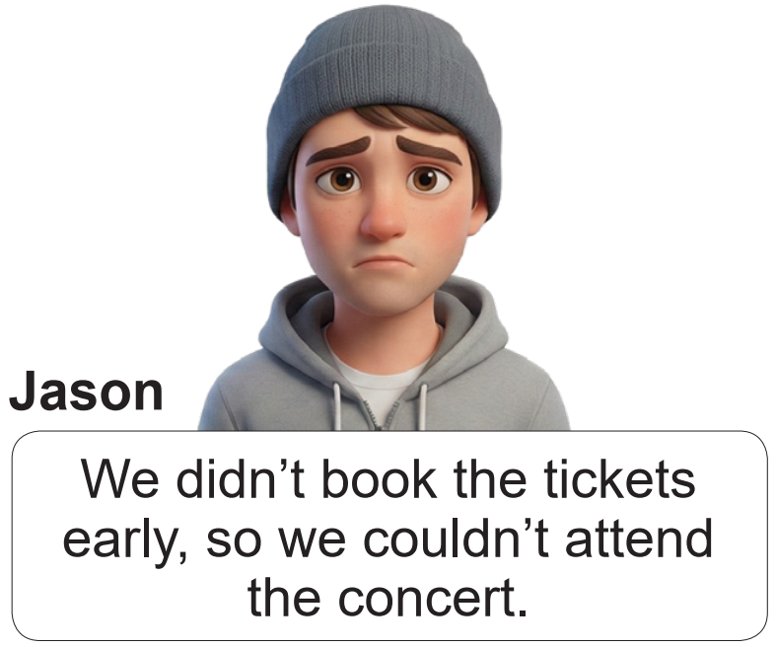
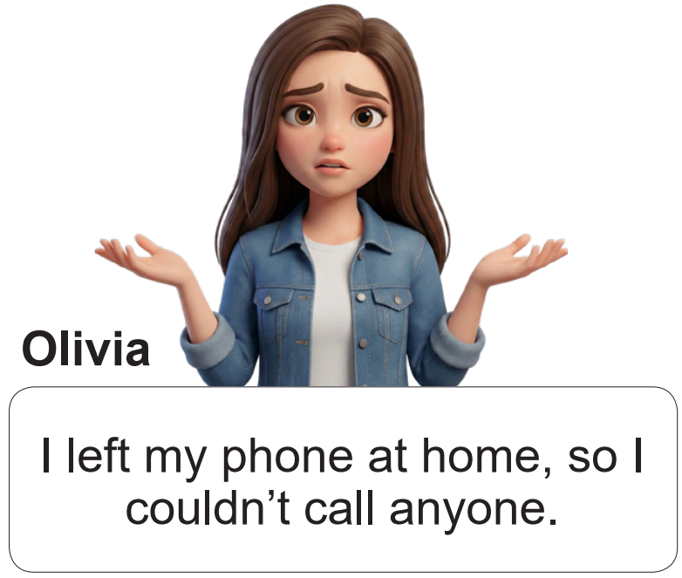
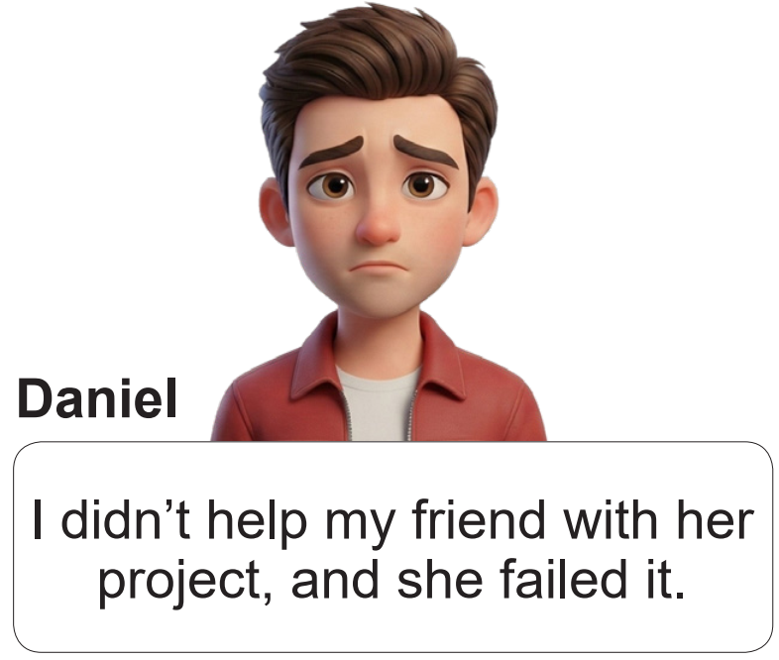
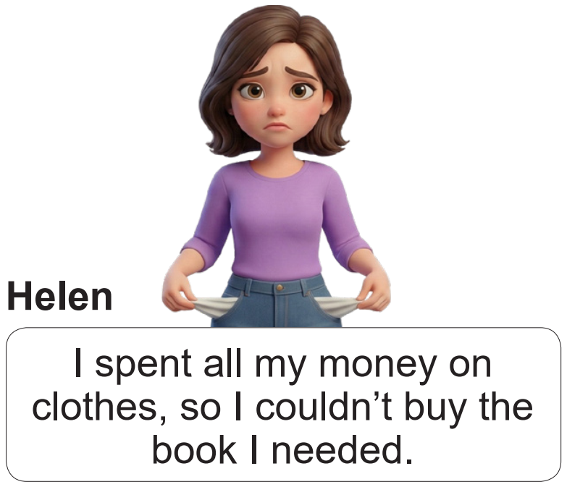





If I had read the exam questions carefully,
I wouldn’t have made silly mistakes.
If we had booked the tickets early, we would have attended the concert.
If I hadn’t left my phone at home, I would have been able to call someone.
If I had helped my friend with her project, she wouldn’t have failed it.
If I hadn’t spent all my money on clothes, I would have been able to buy the book.

Slide 12

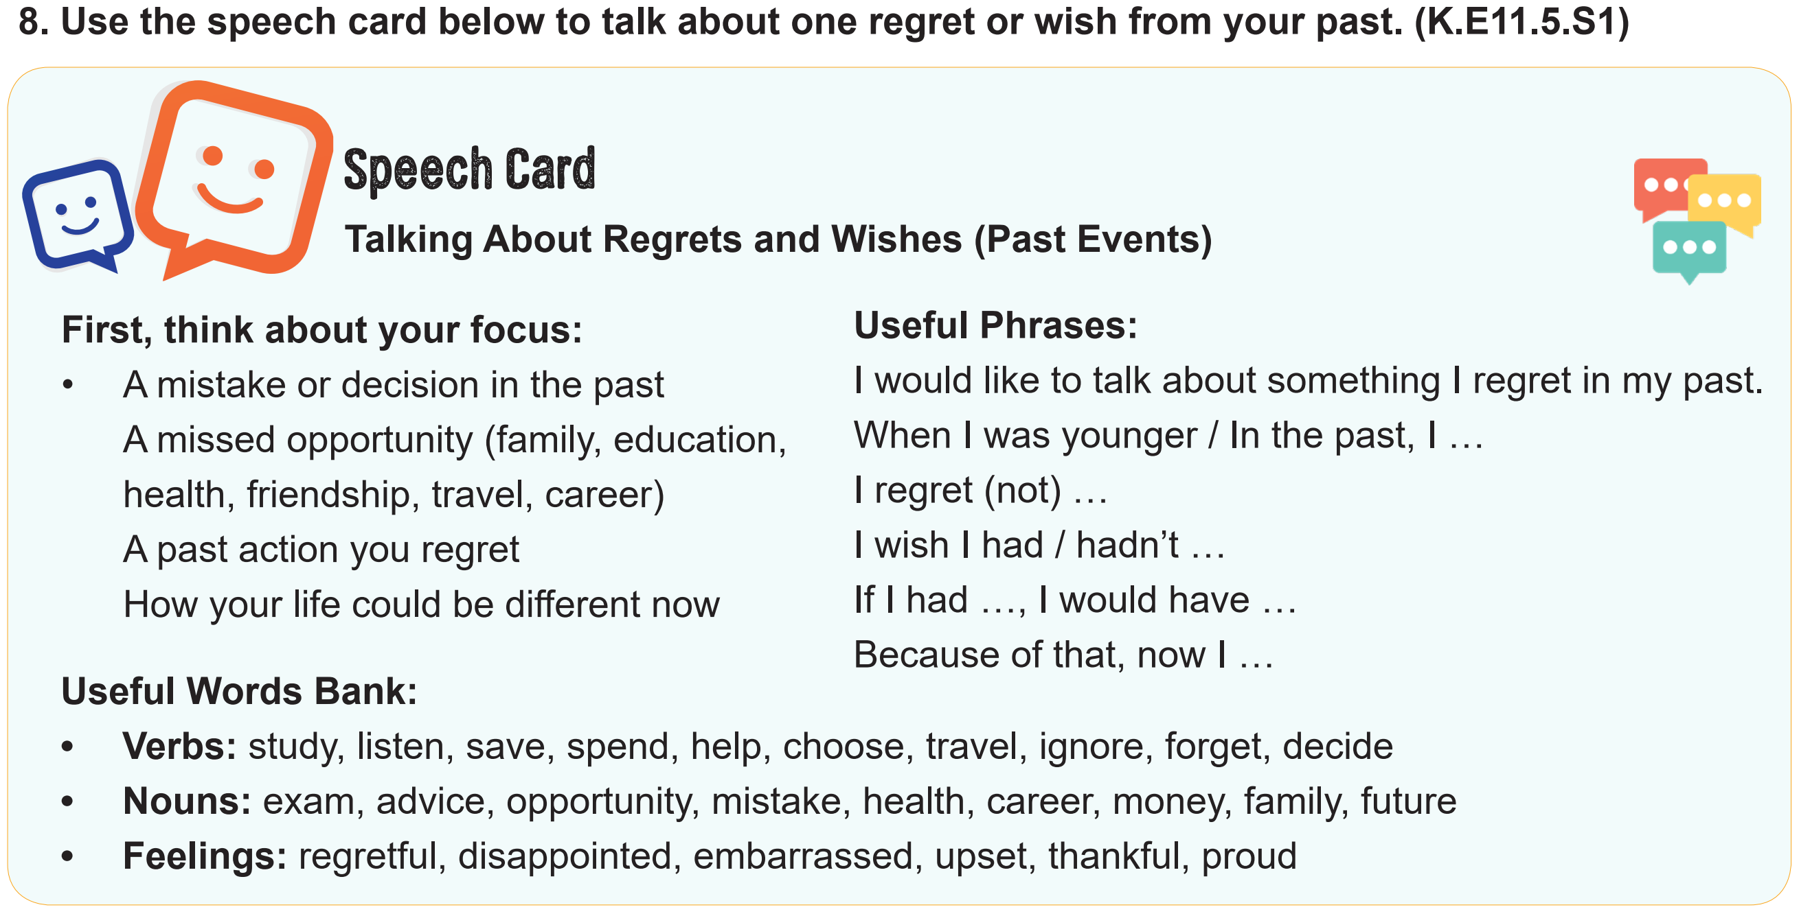

Slide 13
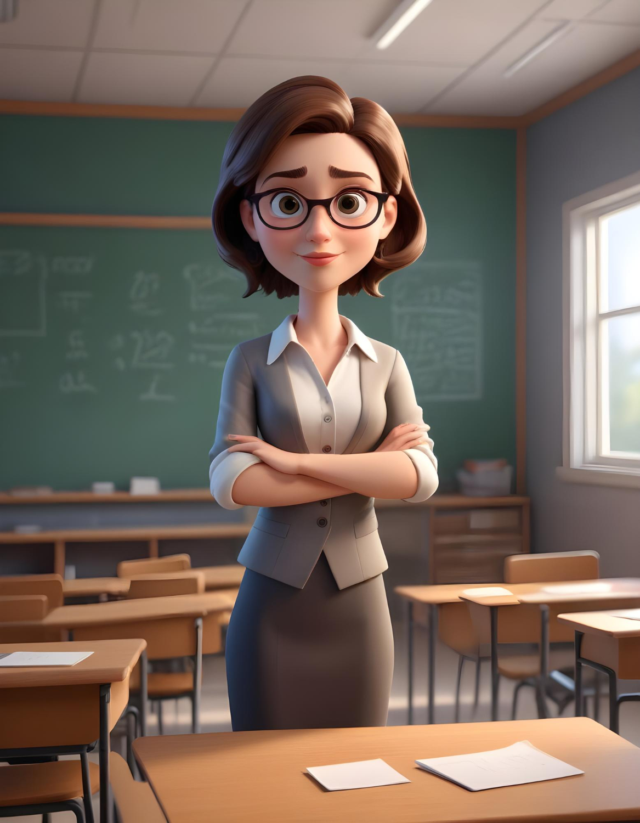


Slide 14
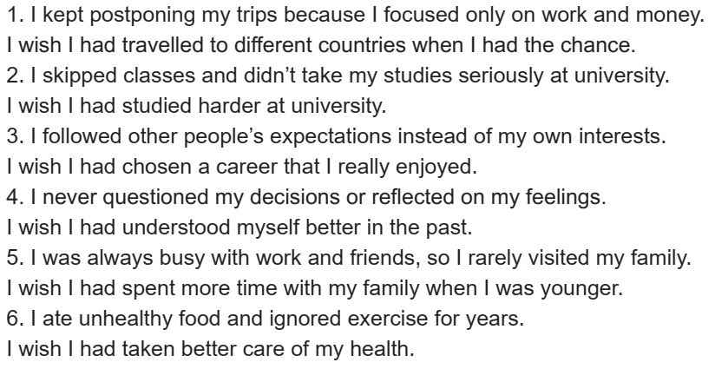
Hide Text

